Slide 1
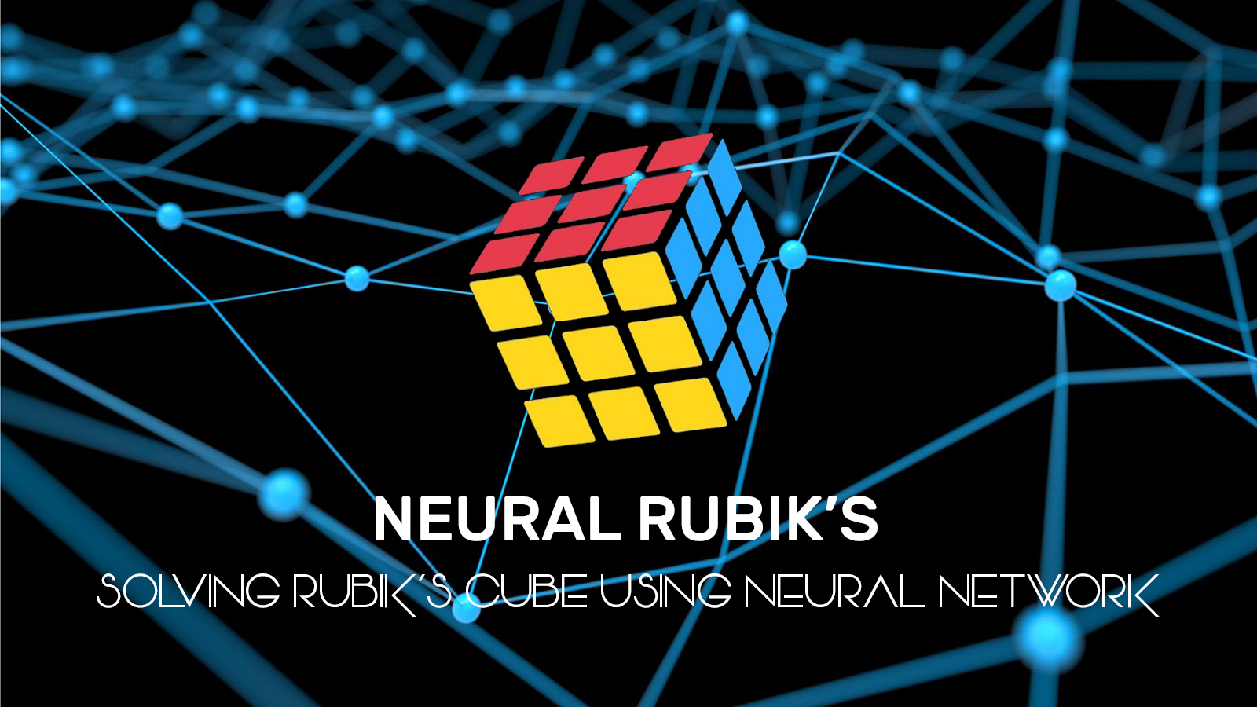
Candidate Name : Gunasegarran Magadevan
Matrix Number : WQD170002
Title : Neural Rubik’s – Solving Rubik’s Cube
Using Neural Network (Heuristic Learning)

Slide 2
CHAPTER 1 : INTRODUCTION
CHAPTER 2 : LITERATURE REVIEW
CHAPTER 3 : RESEARCH METHODOLOGY
REFERENCES
QUESTIONS & ANSWER

Slide 3
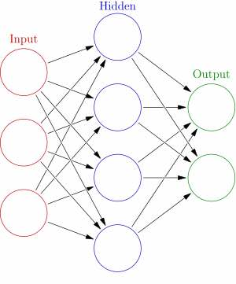
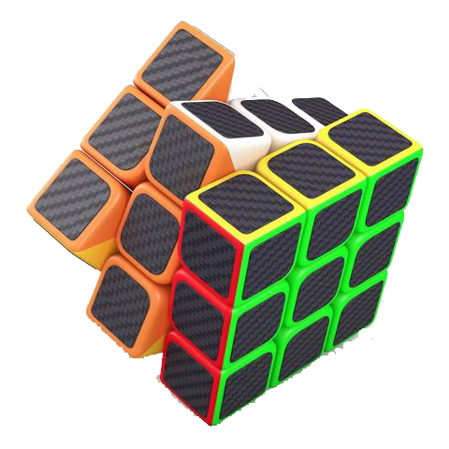
INTRODUCTION
Heuristic learning, involving or serving as an aid to learning, discovery, or problem-solving by experimental methods.
using trial-and-error which can speed up the process of finding a satisfactory solution.
”I have not failed 1000 times, but I have discovered 1000 ways how not to invent the light bulb” - Thomas Edison
The Rubik’s Cube is a 3D mechanical puzzle
The puzzle consists of 26 unique miniature cubes, also called “cubies”
Permutations:
The original (3×3×3) Rubik's Cube has 8 corners and 12 edges.
There are 8! ways to arrange the corner cubes.

Slide 4
INTRODUCTION
Problem
Statement
Implementing heuristic learning to solve a given instance Rubik’s cube problem.
Objective
To automatically solve a given instance Rubik’s cube problem using Heuristic Learning.
Research
Question
This research and experiment will show that the neural network, heuristic learning approach is competitive with state-of-the-art and might be the best choice in some use-case scenarios.
Research
Delivery
To prove this research and experiment of neural network using heuristic learning is the best choice in some use-case scenarios to solve Rubik’s Cube.
Research Significant
Minimal number of prediction of moves to solve a given instance Rubik’s cube.
Train a neural network to predict a minimal number of moves required to solve a given example of Rubik's cube. At that point utilize the trained system as a heuristic distance estimator with a standard forward-search algorithm and compare the results with other heuristics.
Train neural network to predict a min no. of moves required to solve a given case of Rubik’s cube.
Trained neural network as a heuristic distance estimator with a standard forward-search algorithm and compare the results with other heuristics.

Slide 5

LITERATURE REVIEW
Learning | Differences
Pattern Database Learning | A pattern is the partial specification of a permutation (or state); that is, the tiles occupying certain locations are unspecified.
Baseline Learning | A baseline prediction algorithm provides a set of predictions that you can evaluate as you would any predictions for the problem.
Boosting Learning | Boosting is a general method for enhancing the performance of a learning algorithm. It is a method for finding an exceptionally precise classifier on the preparation set, by joining "weak hypotheses”, every one of which needs just to be decently exact on the preparation set.
Autodidactic Iteration | Autodidactic Iteration is new learning algorithm for strengthening that can teach itself how to solve the problem without human assistance. After training, the network then uses a standard search tree to search for each configuration for suggested movements.
Heuristic Learning | A heuristic is a general dependable guideline, normally created through understanding, that is joined into basic leadership process keeping in mind the end goal to tackle an issue. Numerous charts look calculations, for example, A∗, utilize heuristic-based pursuit

Slide 6
RESEARCH
METHODOLOGY
Informed Search:
Admissible Search
Inadmissible Search
A* heuristic can be inadmissible which means that it might sometimes find the non-optimal path. However, it is also more efficient. By biasing the estimate, can choose between path cost and search cost.
Heuristic
QUANTITATIVE REASEARCH
Uses statistics for greater precision and objectivity

Slide 7
REFERENCE
Boris Gorshenev, Progress Report Rubik’s Cube, CMPS 140 - Spring 2018, 2018
D. Silver, A. Huang, et al. Mastering the game of Go with deep neural networks and tree search. Nature, 2016.
E. D. Demaine, S. Eisenstat, and M. Rudoy. Solving the Rubik’s Cube Optimally is NP-complete. ArXiv e-prints, June 2017.
Erez Karpas and Carmel Domshlak. Optimal search with inadmissible heuristics. In Proceedings of International Conference on Automated Planning and Scheduling, 2012.
Francisco Javier Ordóñez and Daniel Roggen. Deep Convolutional and LSTM Recurrent Neural Networks for Multimodal Wearable Activity Recognition, 2016.
Irwan Bello, HieuPham, QuocV.Le, MohammadNorouzi, and Samy Bengio. Neural Combinatorial Optimization , November, 2016.
Jordan Thayer, Austin Dionne, and Wheeler Ruml. Learning inadmissible heuristics during search. In Proceedings of International Conference on Automated Planning and Scheduling, 2011.
Leedy, P. D., Practical research: planning and design. New Jersey: Prentice-Hall, 1993.
Matej Moravcˇík et al. DeepStack: Expert-level artificial intelligence in heads-up no-limit poker. Science, 2017.
Mehdi Samadi, Ariel Felner, and Jonathan Schaeffer. Learning from multiple heuristics, 2016.
Nathan R.Sturtevant, Ariel Felner, and MalteHelmert. Exploiting the rubik’s cube 12-edge PDB by combining partial pattern databases and bloom filters. In Stefan Edelkamp and Roman Barták, editors, Proceedings of the Seventh Annual Symposium on Combinatorial Search, SOCS 2014. AAAI Press, 2014.
Stephen McAleer, Forest Agostinelli, Alexander Shmakov, Pierre BaldiStephen McAleer, Forest Agostinelli, Alexander Shmakov, Pierre Baldi. Solving the Rubik's Cube Without Human Knowledge, 2018.
Stuart J. Russell and Peter Norvig. Artificial Intelligence: A Modern Approach. Prentice Hall, 3 Edition, 2010.
Thomas Keller, Florian Pommerening, Jendrik Seipp, Florian Geißer, and Robert Mattmüller. State-dependent cost partitioning’s for cartesian abstractions in classical planning. In Proceedings of the 25th International Joint Conference on Artificial Intelligence (IJCAI 2016), 2016.
Youssef Hamadi, Eric Monfroy, Springer-Verlag, and Frédéric Saubion. Autonomous search, 2012.
B. Csáji, “Approximation with artificial neural networks,” MSc. thesis, 2001.

Slide 8

QUESTION
&
ANSWER

